Slide 1
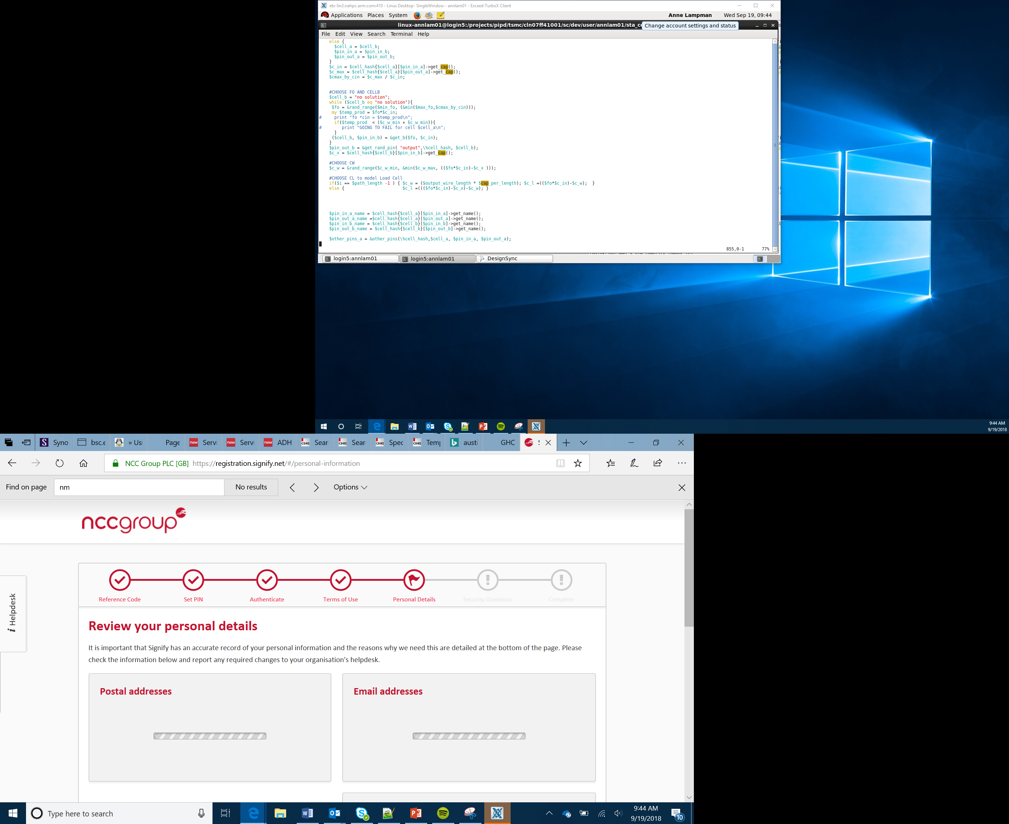

IoT Tree Protector
Lesson 19

Slide 2

Notes:
Introduce the concept of the global goals

Slide 3
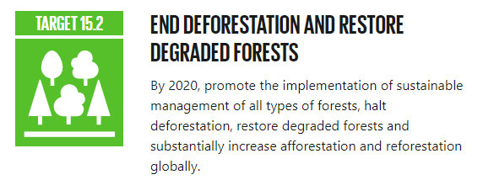
Notes:
Discuss why this target is important

Slide 4
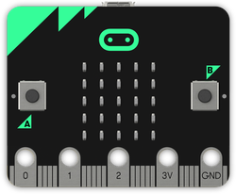
Success criteria
Can be attached to a tree securely
Alerts the authorities if the tree is cut down
Gives the authorities the location of the fallen tree

Slide 5
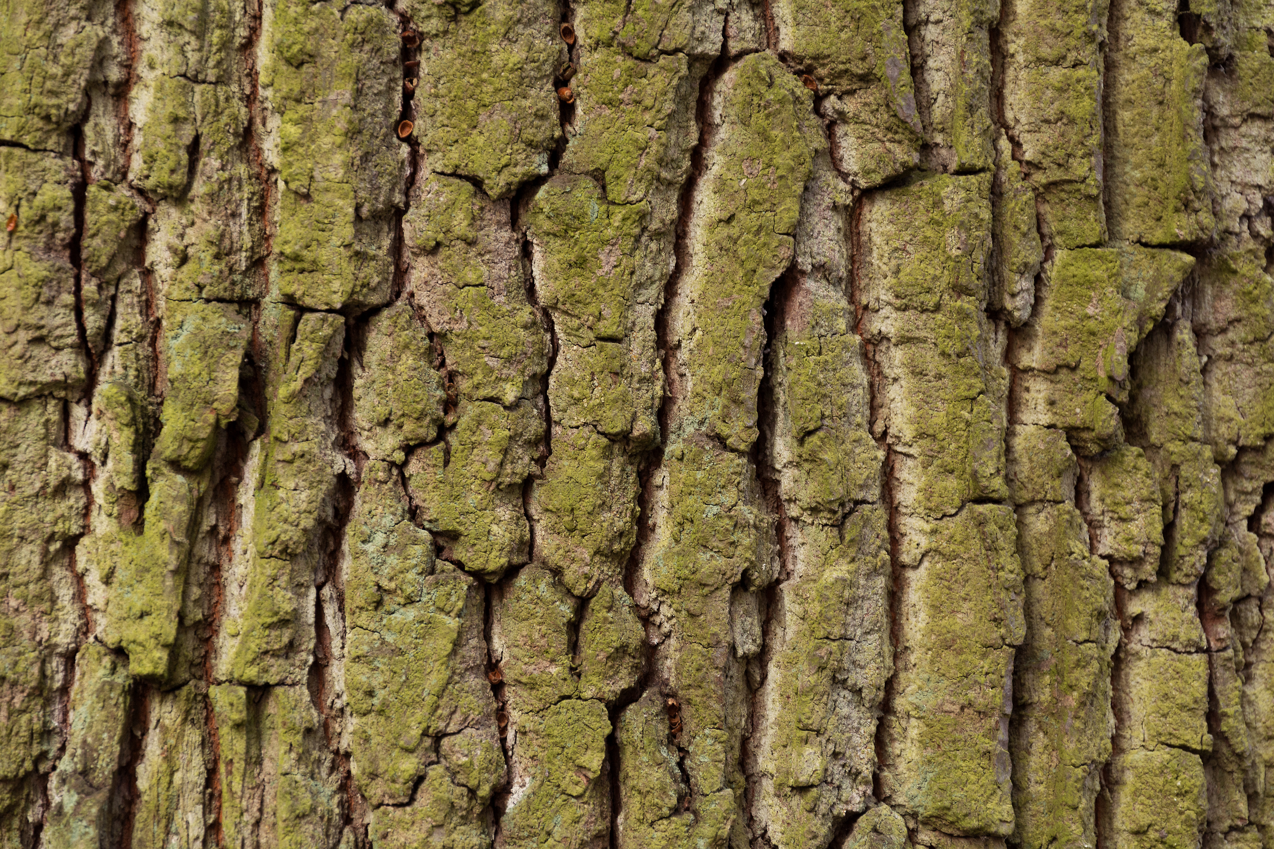
NODE
GATEWAY
(to the internet)
Radio blocks
Is attached to the tree
With the authorities
Notes:
Explain to students that a node is any device that is connected to a network. When a node wishes to access the Internet it is connecting to a different type of network. It will therefore connect to a Gateway. A gateway is also a node but it is one that is used to connect to a different type of network, in this example the Internet.

Slide 6
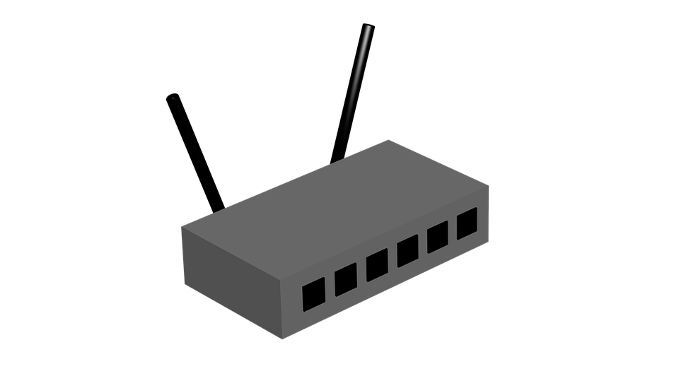

3/4/5G
WiFi
LoRa
Sigfox
Long range
GATEWAY
(to the internet)
Authorities
IRL:
Node transmits to gateway over a long range using 3G (mobile network) or LoRa/SigFox
Gateway receives data and then transmits it to the internet
The authorities receive the data on a PC or mobile device
NODE

Slide 7
What are we going to sense?
After
Before

Slide 8
Input process output
Input | Process | Output
Acceleration and tilt sensor data to sense if tree is falling over | If acceleration of angle of sensor exceeds a threshold then output | Send message to authorities including location data
Input | Process | Output
Receive alert from node | Format the data | Message on screen showing alert and GPS co-ordinates

Slide 9
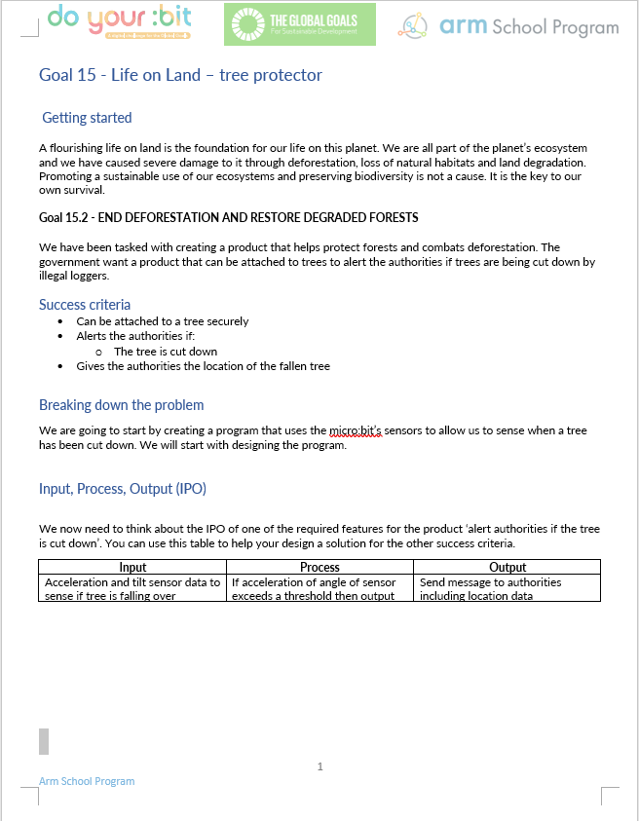
Group task:
Get into pairs/groups
Use the Tree Protector worksheet to help you design and create your product
The product must meet the success criteria
Make a model tree to test your product
Notes:
Provide the worksheet to the learners.

Slide 10
Success criteria
Can be attached to a tree securely
Alerts the authorities if the tree is cut down
Gives the authorities the location of the fallen tree

